Slide 1


Advancing Exploration: Integrating Cloud Computing for Mineral Exploration
Shadrach S. Sheriff
Exploration Geologist
DMW LOVOL Engineering Ltd.

Slide 2
OUTLINE
Introduction
Geological Setting
General Architecture
Data Acquisition and Preprocessing
Spectral Indices
Results
Conclusion and Next Step

Slide 3
Introduction
Traditional exploration is costly and time-intensive
Cloud-based platforms enable data-driven reconnaissance
Objective: Develop a reproducible workflow for prospectivity mapping
Application in the Nigerian Younger Granite Province for Cassiterite (Tin ore) and Monazite (Light REE)

Slide 4
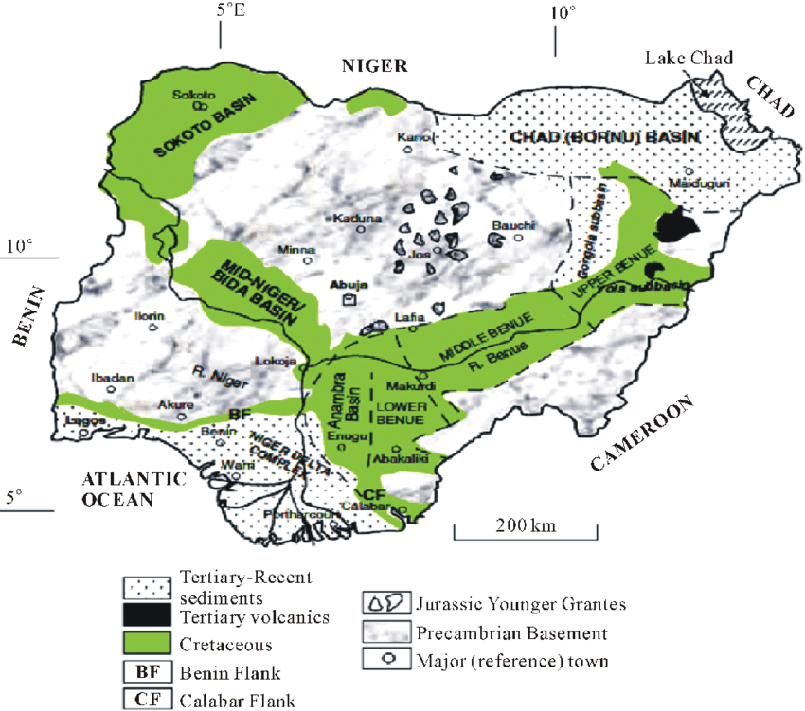
Geological Setting
Younger Granite Province: Jurassic anorogenic ring complexes
Hosts cassiterite, columbite-tantalite, Monazite, and Iron
Key deposits linked to hydrothermal alteration
Alteration footprints mapped via remote sensing

Slide 5
Geospatial Architecture
Google Earth Engine (GEE): Data
MyDDE: Cloud lab for workflow execution and computation engine
Integration ensures reproducibility and data persistence
Combined strengths for scalable mineral exploration
Data Acquisition (GEE)
Preprocessing (Cloud & Vegetation Masking)
Feature Engineering (Indices, PCA, DEM, Texture)
Unsupervised Classification (k-Means)
Mineral Prospectivity Map

Slide 6
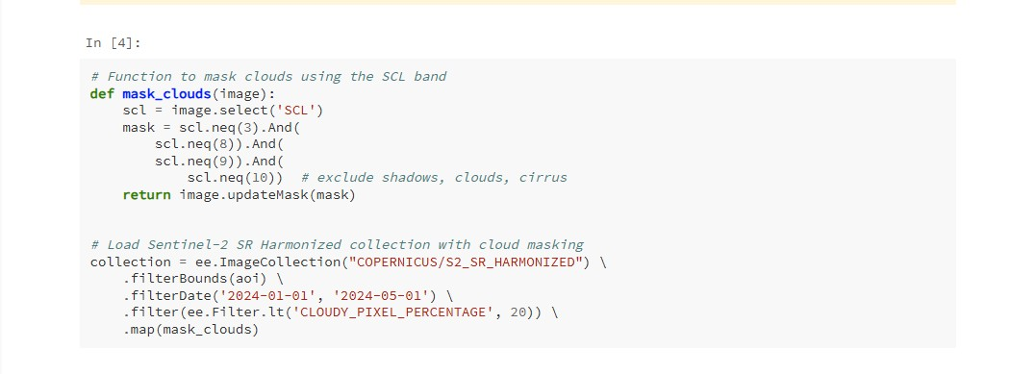
Data Acquisition & Preprocessing
Sentinel-2 MSI: 13 spectral bands (10–60 m resolution)
Cloud and vegetation masking (NDVI < 0.3)
Focus on exposed rocks and soils
Prepared dataset for PCA and clustering

Slide 7
Advanced Geospatial Analysis
Spectral Indices:
Iron Oxide Index (IOI): (B4 - B2) / (B4 + B2)
Clay Mineral Index (CMI) (B11 - B12) / (B11 + B12)
Normalized Difference Soil Index (NDSI) - difference between the SWIR (B11) and Red (B4) bands ((B11 - B4) / (B11 + B4))
PCA for dimensionality reduction
Ancillary data: Slope (DEM), GLCM Contrast
Notes:
Iron Oxide Index (IOI): This index targets the presence of ferric iron oxides, such as manganiferrous Ilmenite, which is usually found within granite bodies. These minerals exhibit high reflectance in the red band and strong absorption in the blue band.²² The code calculates the IOI using a normalized difference formula:
This highlights areas with strong iron alteration, which often correlates with mineralization.²⁴
Clay Mineral Index (CMI): This index is designed to detect hydrous minerals, such as clays, that are primary indicators of hydrothermal activity.¹³ Clay minerals like kaolinite and smectites have characteristic absorption features in the short-wave infrared (SWIR) portion of the spectrum, particularly around 2.2 µm.²⁵ The workflow computes the CMI using the formula
(B11 - B12) / (B11 + B12), which effectively highlights these hydrous mineral zones by exploiting the differential reflectance between the two SWIR bands.²⁰
Normalized Difference Soil Index (NDSI): The NDSI used in this analysis, calculated as a normalized difference between the SWIR (B11) and Red (B4) bands ((B11 - B4) / (B11 + B4)) ²³, is a custom index tailored to the specific geology of the Younger Granite Complex. While a similarly named index exists for snow mapping ²⁷, in this context, the combination of a SWIR band (sensitive to water content and certain mineralogy) and a red band is likely designed to highlight exposed, silica-rich lithologies, which are characteristic of the Younger Granites.⁴ This bespoke approach allows the analyst to specifically target the unique spectral properties of the host rocks, demonstrating a refined level of analytical customization.

Slide 8
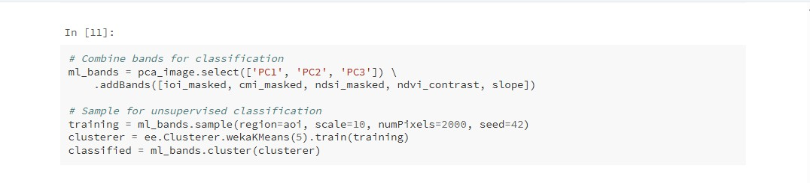
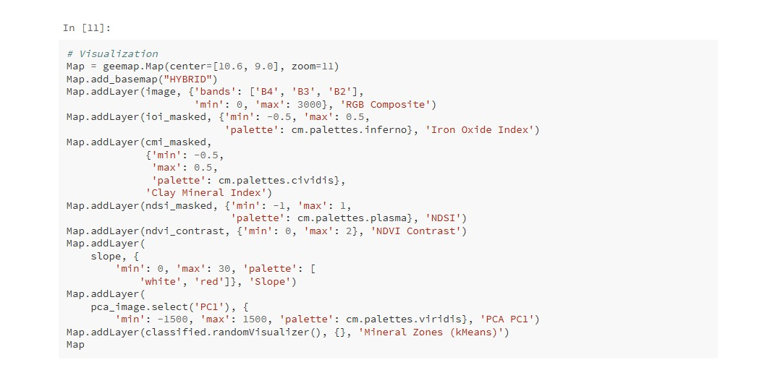
Classification & Results
k-Means clustering (5 classes)
Input: PCA components, indices, slope, texture
Generated mineral prospectivity map

Slide 9
summary
Cloud-native methodology for mineral prospectivity mapping
Utilized MyDDE platform and Google Earth Engine (GEE)
Applied spectral indices, PCA, and k-Means clustering
Identified prospective mineral zones
Demonstrates scalable, cost-effective, reproducible approach

Slide 10
Conclusion & Next Steps
Demonstrated reproducible cloud-native workflow
Scalable and cost-effective for reconnaissance mapping
Empowers local geoscientists with digital tools
Next: Field validation, supervised classification,

Slide 11
appreciation
Professor Mike Stephenson
Dr. Ish
DDE Team
Professor Gbenga Okunlola
Professor A. S. Olatunji

Slide 12

Thank you
Shadrach Sehmilo Sheriff
+2348 147 334 819
shadrachsehmilo@gmail.com
www.linkedin.com/in/shadrach-sheriff-100s/

